Slide 1


How can we understand and develop the capability of VCSE workforce to have conversations that challenge, encourage, and empower people to make positive change?
The vision and aim
What are behavioural skills ?
Implementation thoughts (as we start out)
Round of clarifications – please jot in the chat
Group discussion : your thoughts and suggestions
  What does it make you think about?
  What are you thinking about it?
  What do you suggest – ideas?
  What might be a good next step?

Slide 2
Vision :
To enable people to thrive by feeling more motivated, confident and in control of managing their own health and wellbeing.
Great conversation is more than just exchanging information – it can transform relationships and health behaviours to benefit people, staff and the work of organisations that support them.
1. Empower people in your communities to self-manage their health and wellbeing
2. Encourage people make behaviour change in order for your interactions to have more impact
3. Improve peoples lives and make our working lives easier
Notes:
An overarching vision for whole system
Developing these skill is an enabler for a fundamental shift in model of care that applies across the system – that health is co-created – prof/workers and people together. Shift from thinking that the system can “manufacture” health by creating a perfect health machine (care pathways) though which people can be processed.
Rather, realises that people are the “ghost in the machine” – they have contexts and capabilities and views and challenges to which the system needs to respond in tailored ways.
Way of addressing this is to create partnerships in the engine room of change – the interactions that happen between an individual and those who work with them.
Hence the skills are about having great conversation in that space
To empower people to take role in their own HWB
To be more effective in interactions – improve lives
To feel more empowered ourselves to have the conversations that are difficult and feel more resilient in the work.
Work to give staff the skills for these conversations has been going on in ICS for some years and been amazing feedback from GPs, Frailty workers and people working in Chronic Pain.
Some VCSE have taken part in MI and coaching training but never targeted sector before so patchy, no critical mass and no specific support to sector to embed these skills in real world work.
This initiative aims to address that – and upskill people in community also.

Slide 3
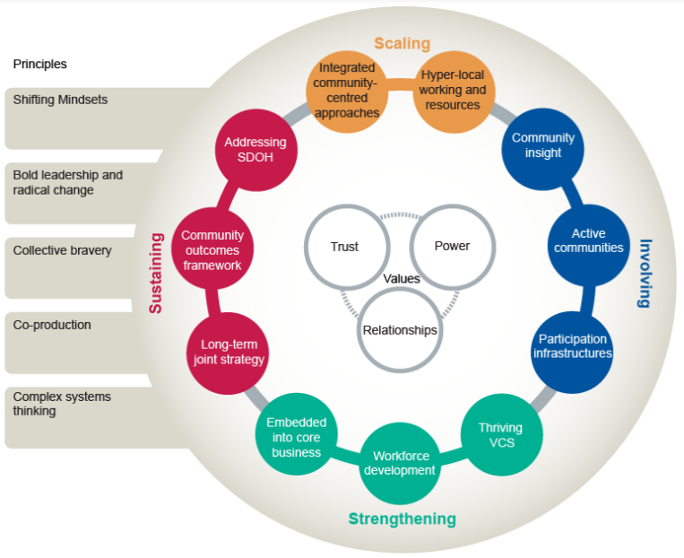
Aim : To invest in Community Workforce to tackle Health Inequalities
Recognises VCSE and community have a key role in addressing inequalities :
Accessed by people who might be struggling or have complex lives and multiple challenges, who don’t come into the statutory system
Recognises that community organisations are trusted by local people to have these honest, non judgemental and holistic conversation and “hold the spaces” for this.
Also that VCSE already lives the values that underpin those conversations - strengths based, enabling and person centred approaches – the mindset for a coaching/behavioural approach.
Intent: To enhance the contribution of VCSE/community by enabling workers to have more effective change conversations
Notes:
Applies to the whole system but particularly to VCSE and community
PHE framework – this is about strengthening and involving – workforce development and Thriving VCS and active communities) “Health” in widest sense – inequality of well being too.
Aim of this funded upskilling programme – increase the capability of VCSE so the contribution of the sector around inequalities can be magnified. PHE model – action on strengthening workforce and investing in thriving VCSE - also about active communities – that these conversations motivate people to make change in their lives and communities
Key role for VCSE and community in inequalities :
Accessed by people who might be struggling or have complex lives and multiple challenges that don’t come into the statutory system
Recognise that in that context some of these conversations can feel challenging but that community is the trusted by local people to have these honest, non judgemental and holistic conversation
Also that VCSE has the values underpin those conversations in ways the expert led statutory services may not – as strengths based, enabling and person centred approaches is a foundation for community work.
The aim is to
Increase the capability of the VCSE/community be impactful with those people in community experiencing inequality
To invest in VCSE/Community workforce and the organisations that support them – sustainable development in the sector
Shape what a upskilling programme might look like with the sector (co-production principle)

Slide 4
Skills to support behaviour change conversations
Questioning skills
Positive Psychology
Principles and models from psychology and behavioural science
Active Listening skills
Using challenge and rapport
Knowledge and skills of the worker
Focus on potential and change talk
Responding to Stages of change
Skills and techniques from performance coaching
Each person holds so much power within themselves that needs to be let out. Sometimes they just need a little nudge, a little direction, a little support, a little coaching, and the greatest things can happen.
Pete Carroll (NFL Coach and Author)
Notes:
He
Skills in mind come under heading behavioural approaches – you may be familiar or new to you.
Integrates workers knowledge, with tools from coaching, concepts from psychology. Evidence based – proven to stimulate action.
Can include a range of tools and techniques but a structured way to use conversation to enable action
Might recognise through courses like Motivational Interviewing, HWB coaching, MECC (making every contact count – HLS orientated).
Interested if people are aware of these conversational tools and/or have taken up this sort of training – ICB courses or elements in own work.

Slide 5
More than just training ….
Defining the Scope of Implementation
1. Introductory Sessions
2. Skills Training
1-4 days
F-F and virtual
Group Learning
Can be modular
4. Embedding in delivery
Such as :
Client communications,
3. Practice development
Supervision and reflective practice space
Learning Resources
Organisational Champions
Engaging managers and team leaders
Support plans
Peer Support
Raising awareness and interest from leaders
Notes:
Thinking about elements of implementation – up for discussion –
Learnt from past that works best if more than just training days – support to engage (pre) and use in real world (practice development)
Training and development
This is how approached in statutory but maybe different in VCSE because heterogeneous sector and resources to support staff education and practice development much more limited (or non existent) – no established training departments or practice supervisors.
So what would help in this sector something like to explore with people in it.

Slide 6
Things to consider at start up …
Who : Audience?
Which parts of the sector might need/want this ?
Sustainability?
How to start to build capacity in sector for ongoing workforce development
Conversations for Change
What: Skills?
Do other skills come into this – beyond behavioural approaches ?
How : Approach?
By patch, type of organisation ?
Phased or big bang?
What sector structures might support?
  And what else?
  What does it make you think about?
  What are you thinking about it?
  What do you suggest – ideas?
  What might be a good next step?
Notes:
Sharing what’s on my mind as start shaping something – not comprehensive
Different things may be coming up for you – start of identifying what’s relevant or important
Mindful that:
Not trained a sector before
That context – VCSE heterogeneity
Demand/engagement - IS it interesting and a priority?
Is it feasible – sector capacity ?
Awareness of infrastructure - is there we could tap into organise training
Are there champions out there – key people who’d be good to involve

